Slide 1
PROJECT on Automatic Room Temperature Controller
GUIDED BY: -
SHUVENDU DAS
BHANU THAKUR
PRESENTED BY: -
SAHIL KAUNDAL
PRATIK KUMAR DEY
ROHIT KUMAR GOSWAMI
FEROJ KHAN

Slide 2
CONTENTS
INTRODUCTION
OBJECTIVES
TECHNOLOGY USED
DESIGNS
SCREENSHOTS
OUTCOMES

Slide 3
INTRODUCTION
An automatic room heater control system is a self-regulating temperature system which uses a set point or value to maintain the temperature of a room. This system allows the user to set a desired temperature which is then compared to the room temperature measured by a temperature sensor and with the help of a microcontroller, the system responds by turning on any of the two loads (Fan or a Heater) automatically depending on the temperature difference. The Fan is triggered on when the room temperature is higher than the set temperature and the Heater is triggered on when the room temperature is lower than the set temperature.

Slide 4
Objectives
The objectives of this project are:
To test its applicability in different temperature ranges as measured by the TMP36 temperature sensor.
To analyses the performance of the controller.
To develop a smart automatic room temperature controller system.
To design and construct an automatic temperature controller to regulate the temperature of a room.
To build an automatic room temperature controller making use of a temperature sensor and a microcontroller.
To achieve the design of an alert system for the temperature controller.

Slide 5
Technologies used
Arduino Uno
Breadboard Small
DC Motor
NPN Transistor
Temperature Sensor [TMP36]
LCD 16*2
250 Kilo Ohm Potentiometer
221 Ohm Resistor
LED
Diode
Jumper Wires

Slide 6
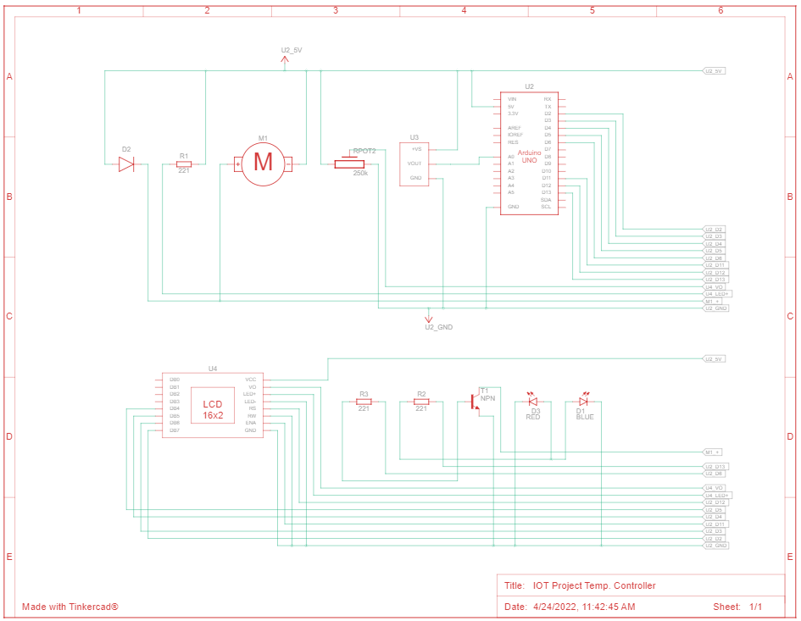
CIRCUIT DESIGN

Slide 7
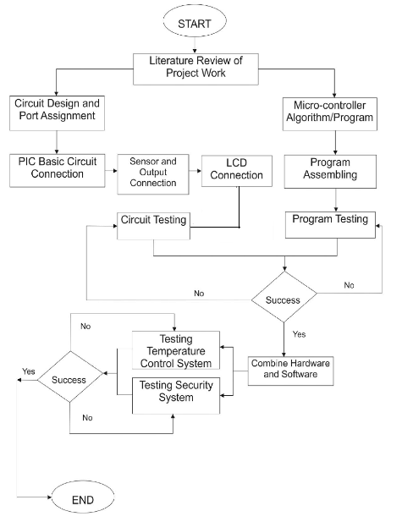
Flowchart

Slide 8
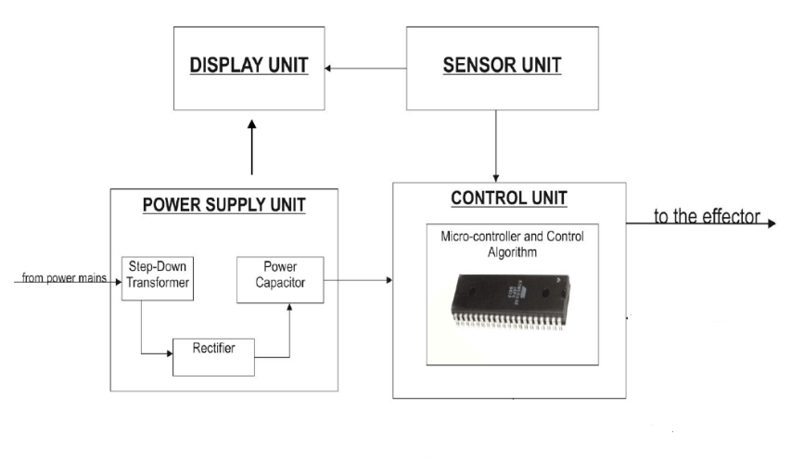
DFD

Slide 9
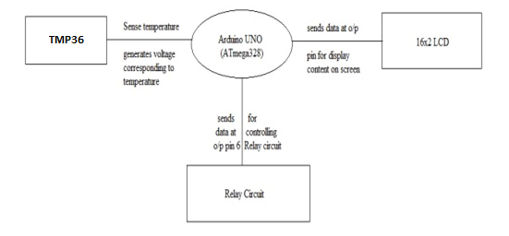
dfd

Slide 10
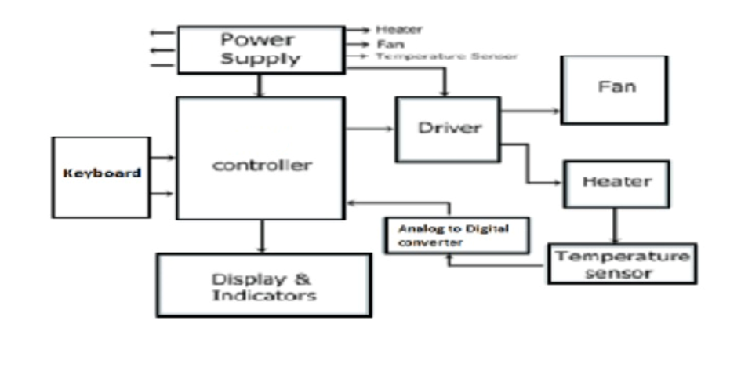
DFD

Slide 11
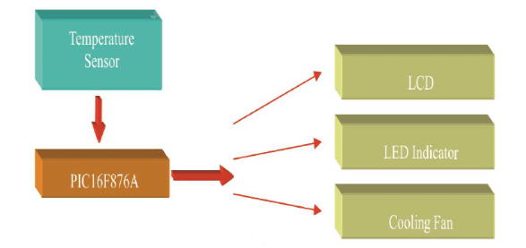
Block Diagram

Slide 12
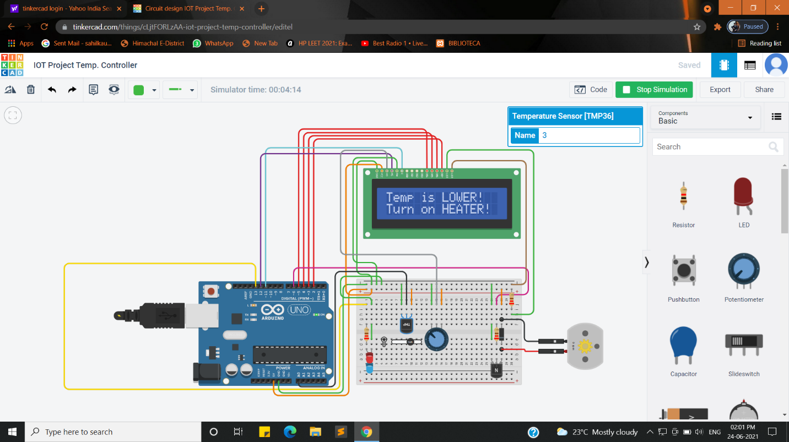
ScreenShots

Slide 13
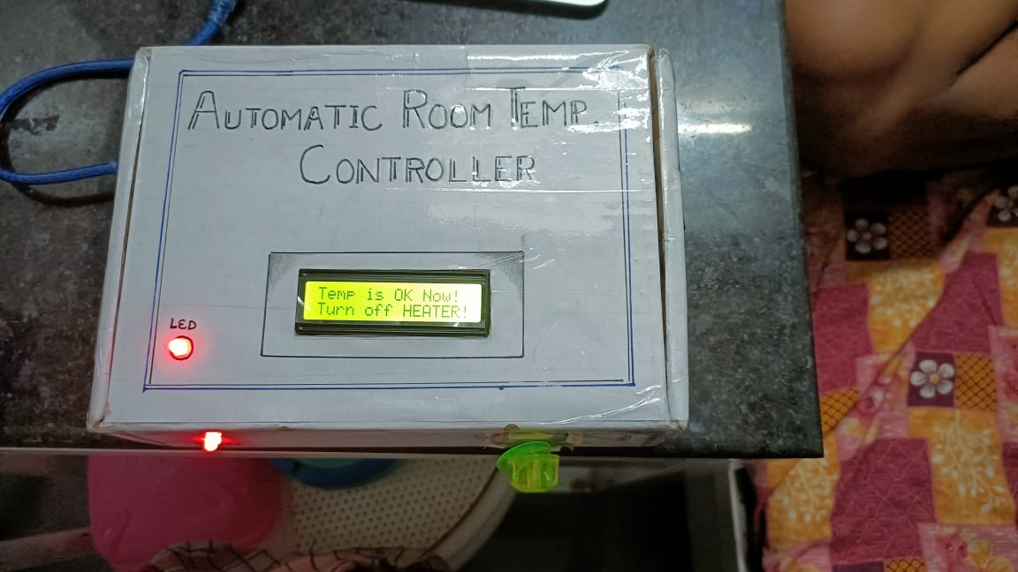
SCREENSHOTS

Slide 14
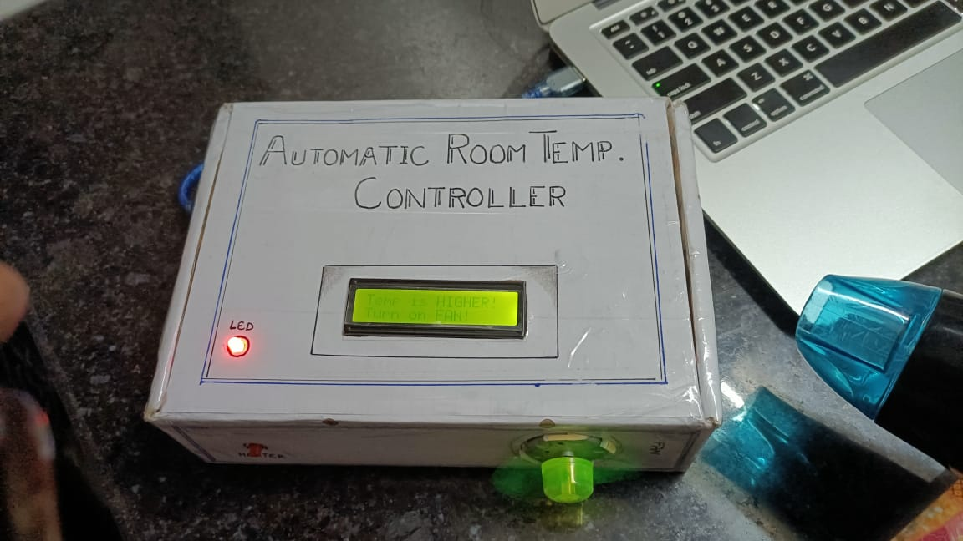
screenshots

Slide 15
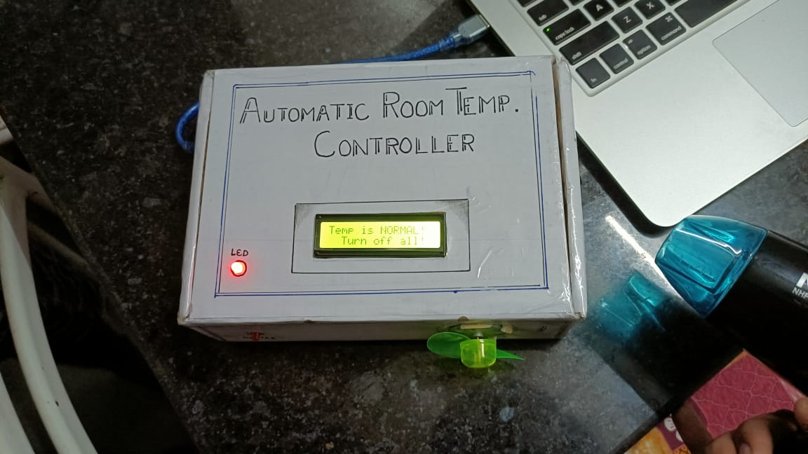
screenshots

Slide 16
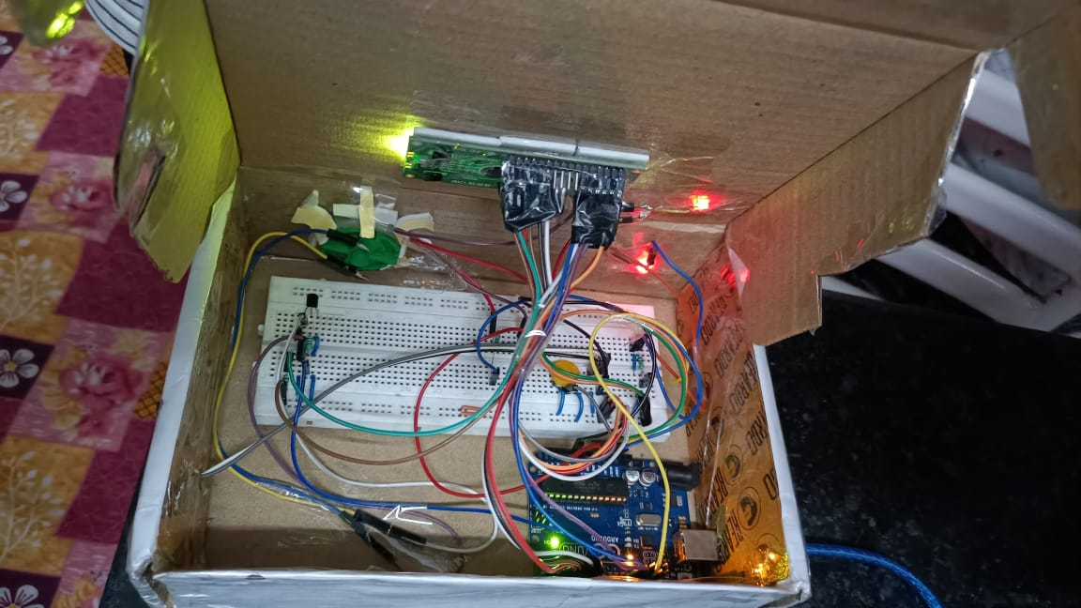
screenshots

Slide 17
OUTCOMES
The main outcomes of this Automatic Room Temperature Controller is to control the temperature of any device like Fan or any other electronic devices whose temperature keeps fluctuating and thus requires a constant watch on the device. The use of this system eliminates constant watching on the device by self controlling the temperature of the system.
Our outcomes of this project consists of digital temperature sensors for more accurate temperature control in various industries. Our system overcomes the disadvantages of thermostat/analog systems in terms of accuracy. This system can be used in any firm or organization where it is very important to maintain precise temperatures.
LCD display is used to display the temperature and when the temperature exceeds the set limit, the led is switched off in order to control the temperature. The heater is demonstrated with the help of a led. After the heater is switched off, the Fan is switched ON. Here Fan is demonstrated with the help of small DC Motor fan.
After the fan is switched ON, it remains ON until the temperature reaches below the exceed limit. Thus the system keeps on switching ON/OFF the heater or the AC for automatically controlling the temperature of the system.

